Slide 1

Green Pace
Security Policy Presentation
Developer: Leah Marshall

Slide 2

OVERVIEW: DEFENSE IN DEPTH
This Security Policy defines C/C++ coding standards, authorization, authentication, auditing and data encryption standards. This policy was implemented to maintain a comprehensive security mindset throughout the company.

Slide 3
THREATS MATRIX
Likely STD-003-CPP Attempting to create a std::string from a nullptr | Priority STD-001-CPP Not obeying the one-definition rule
Low priority STD-006-CLG Not using static assertion to test the value of a constant expression | Unlikely STD-008-CPP Not writing constructor memory initializers in the canonical order

Slide 4
10 PRINCIPLES
Validate Input Data
STD-002, STD-004, STD-010
Heed Compiler Warnings
STD-003, STD-005, STD-006
Architect and Design for Security Policies
STD-001, STD-006, STD-008, STD-009, STD-010
Keep It Simple
STD-001, STD-002, STD-008
Default Deny

Slide 5
10 PRINCIPLES
Adhere to the Principle of Least Privilege
Sanitize Data Sent to the Other Systems
STD-004
Practice Defense in Depth
Use Effective Quality Assurance Techniques
STD-007, STD-005
Adopt a Secure Coding Standard
STD-009, STD-007

Slide 6
CODING STANDARDS
Obey the one-definition rule
High Severity but low likelihood
Do not read uninitialized memory
High Severity and very probable
Do not attempt to create a std::string from a nullptr
High Severity and likely
Prevent a SQL injection
High Severity and likely
Do not access freed memory
High Severity and likely

Slide 7
CODING STANDARDS
Use static assertion to test the value of a constant expression
Low severity and unlikely
Do not abruptly terminate the program
Low severity and probable
Write a constructor memory initializers in the canonical order
Medium severity and unlikely
Do not cast out of range enumeration values
Medium severity and unlikely
Never qualify a reference type with const or volatile
Low severity and unlikely

Slide 8
ENCRYPTION POLICIES
Encryption at Rest
Can be done through disk encryption, DLP protections, extending loss prevention to cloud
Encryption in Flight
Can be done through simple firewalls, authentication, automated controls, and email encryption
Encryption in Use
Protection should start before use

Slide 9
TRIPLE-A POLICIES
Authentication
“act of confirming the truth of an attribute of a single piece of data claimed true by an entity”
Authorization
Least Privilege ensures users are only accessing information that they are authorized for
Accounting
“the process that keeps track of a user’s activity while attached to a system”

Slide 10
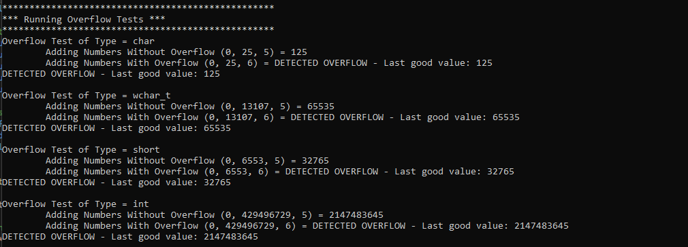
Unit Testing - Buffer Overflow

Slide 11
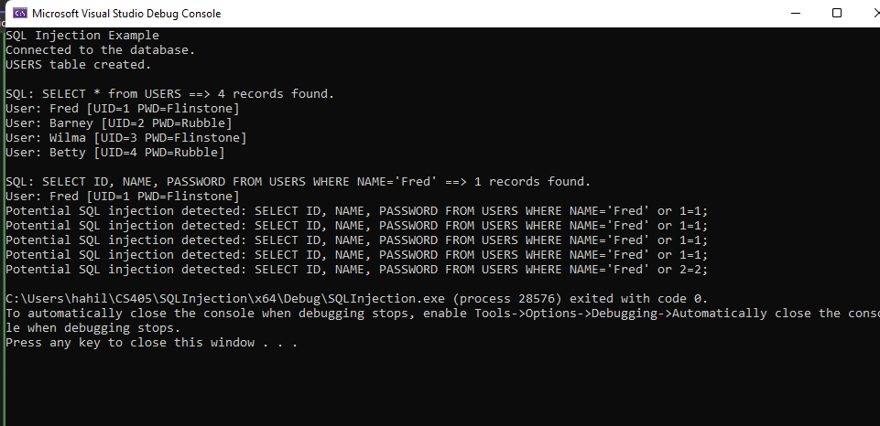
Unit Testing - SQL Injection

Slide 12
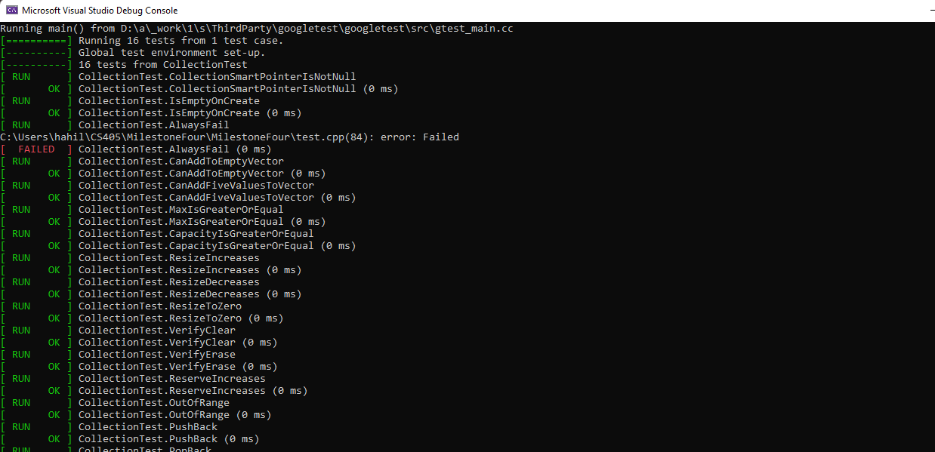
Unit Testing-Collection Tests

Slide 13
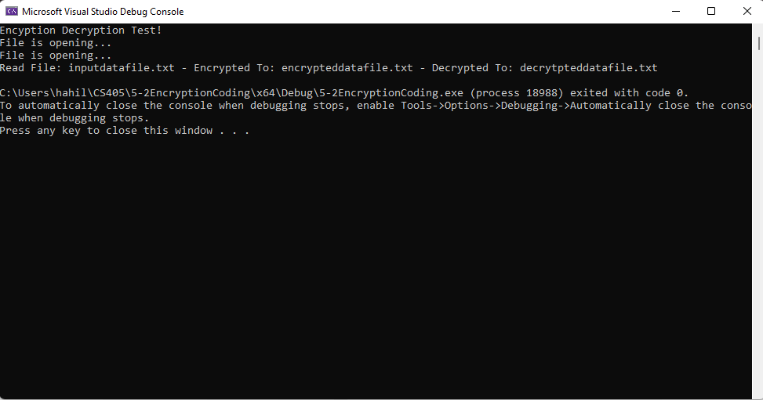
Unit Testing-Encryption/Decryption

Slide 14

AUTOMATION SUMMARY

Slide 15
TOOLS
Pre-Production
Assessing & Planning
Examine potential vulnerabilities, ranking accordingly, and adjusting to regulation changes
Design
Ahere to OWASP principles
Building, Verifying, and Testing
Validate against standards, check for vulnerabilities, and implement security practices
Production
Transition & Check Check
Secure setups and penetration tests
Monitoring and Detection
Deploy the product, establish log analysis and detection monitoring
Repond, Maintain & Stabilize
Assess and respond to threats, maintaining the system

Slide 16
RISKS AND BENEFITS
Acting Now
Reduces the impact of penetration to the system
Creates a securely layered system which has multiple safeguards in case one point fails
Prevents the loss/theft of important information
Waiting to Act
Increases chance of data breaches, ransomware, scams, etc. to go unnoticed
Dramatically increases the chance of a devastating attack

Slide 17
RECOMMENDATIONS
Simplifying the coding standards and principles for non-technical users
Having all employees maintaining these standards is important
Emphasize secure practices in non-technical departments
Many vulnerabilities occur due to phishing and other social engineering attacks

Slide 18
CONCLUSIONS
Further Standards that should be Adopted:
Code Formatting & Best Practices
Makes the code easier to read, maintain, and reduces chance of errors
Consistency
Makes it easier to maintain quality, switching between tasks, etc.

Slide 19
REFERENCES
OWASP. (n.d.). Buffer overflow. Buffer Overflow | OWASP Foundation. https://owasp.org/www-community/vulnerabilities/Buffer_Overflow
What is SQL Injection (sqli) and how to prevent attacks. Acunetix. (2024, January 9). https://www.acunetix.com/websitesecurity/sql-injection/#:~:text=An%20SQL%20Injection%20vulnerability%20may,%2C%20intellectual%20property%2C%20and%20more.
QA Automation, QA Automation. (n.d.). How do you use encryption and decryption techniques in automation testing?. Encryption and Decryption Techniques for Automation Testing. https://www.linkedin.com/advice/0/how-do-you-use-encryption-decryption-techniques-automation#:~:text=Encryption%20is%20a%20fundamental%20concept,plaintext%2C%20making%20it%20readable%20again.

